Slide 1
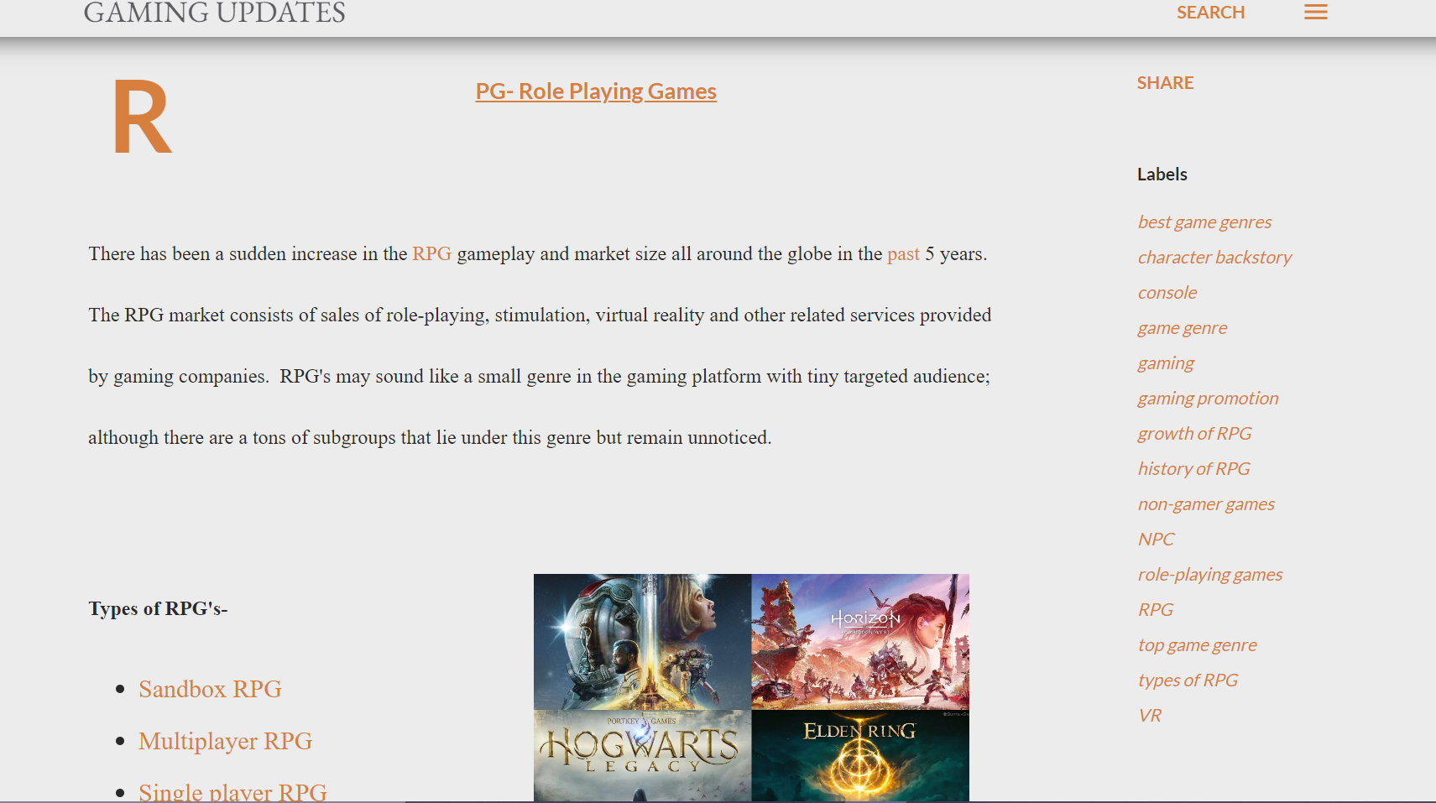
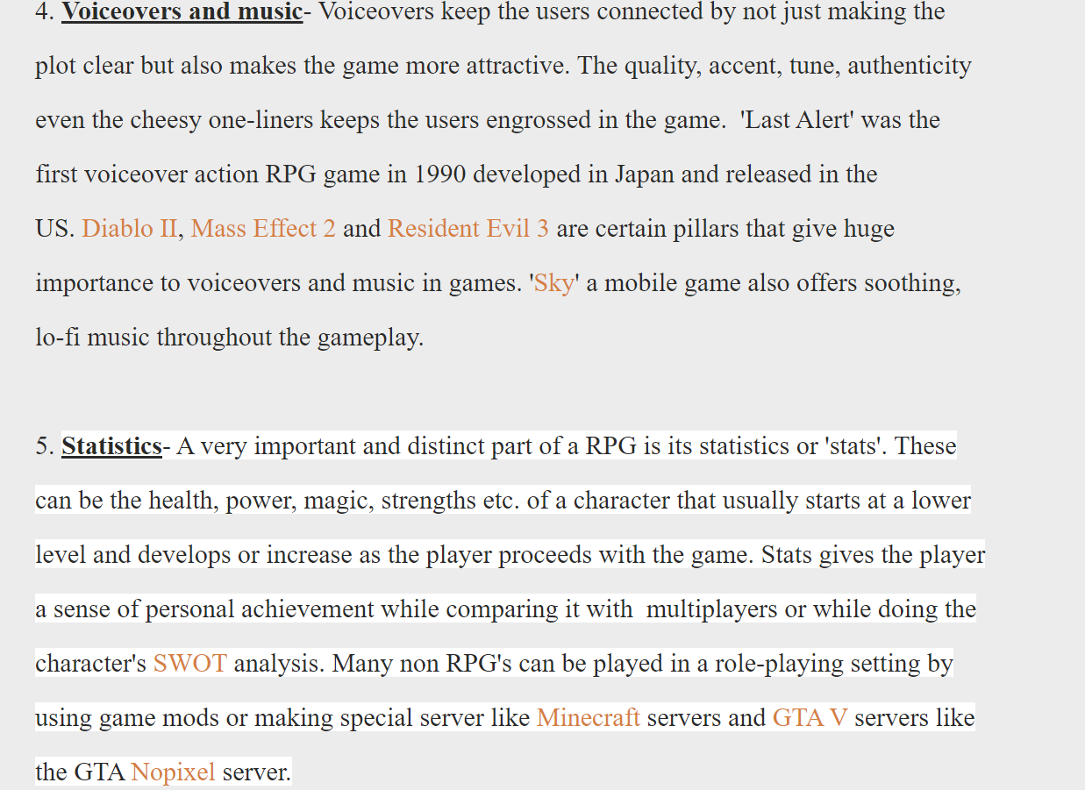
BLOG
https://workspaceblogger.blogspot.com/2022/06/growth-in-role-playing-games.html
http://tominutes.com/

Slide 2

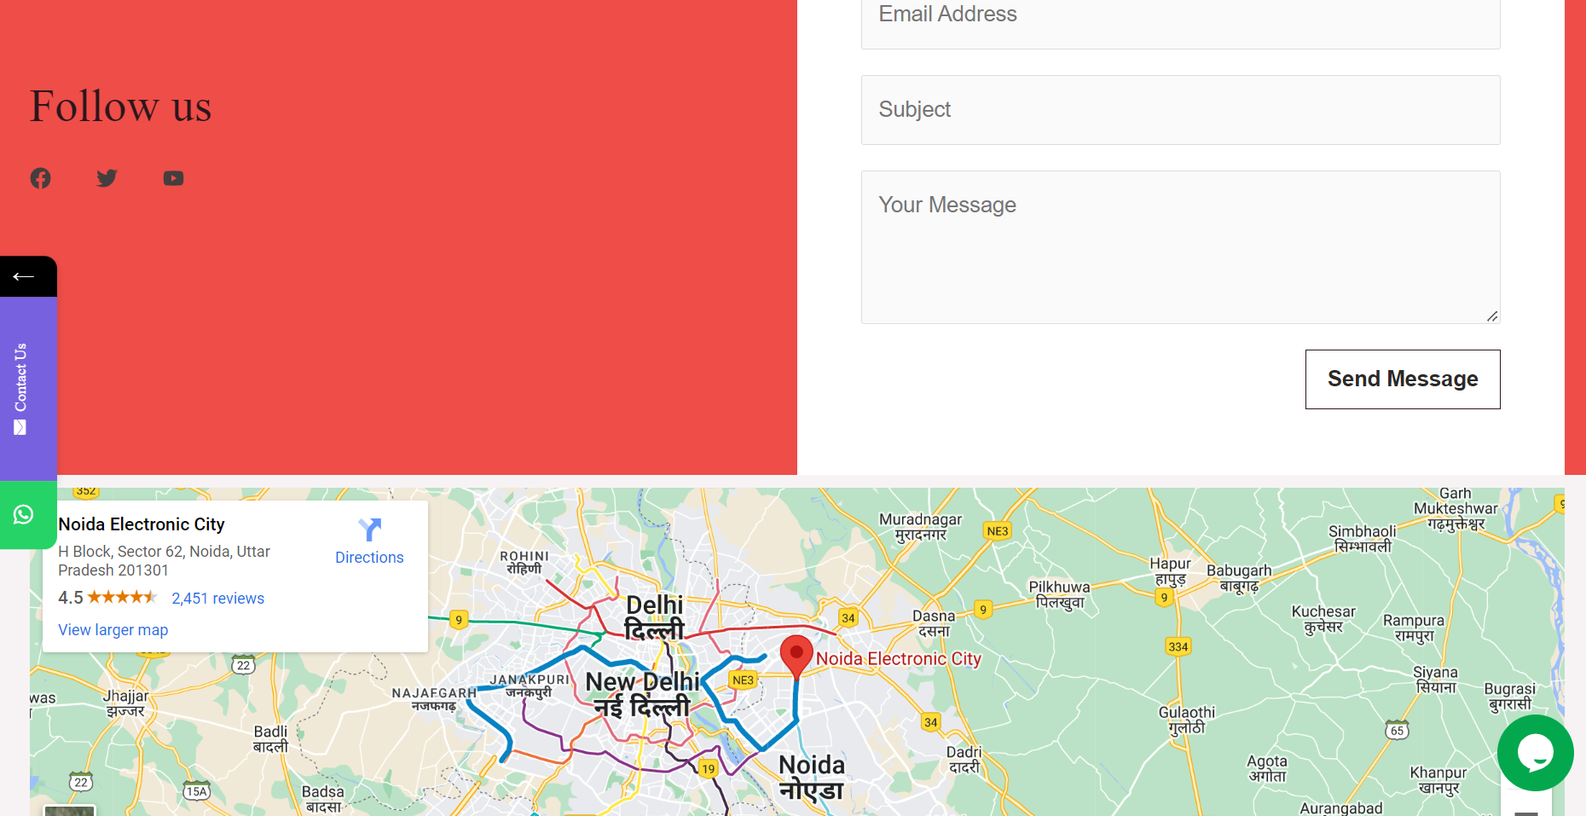
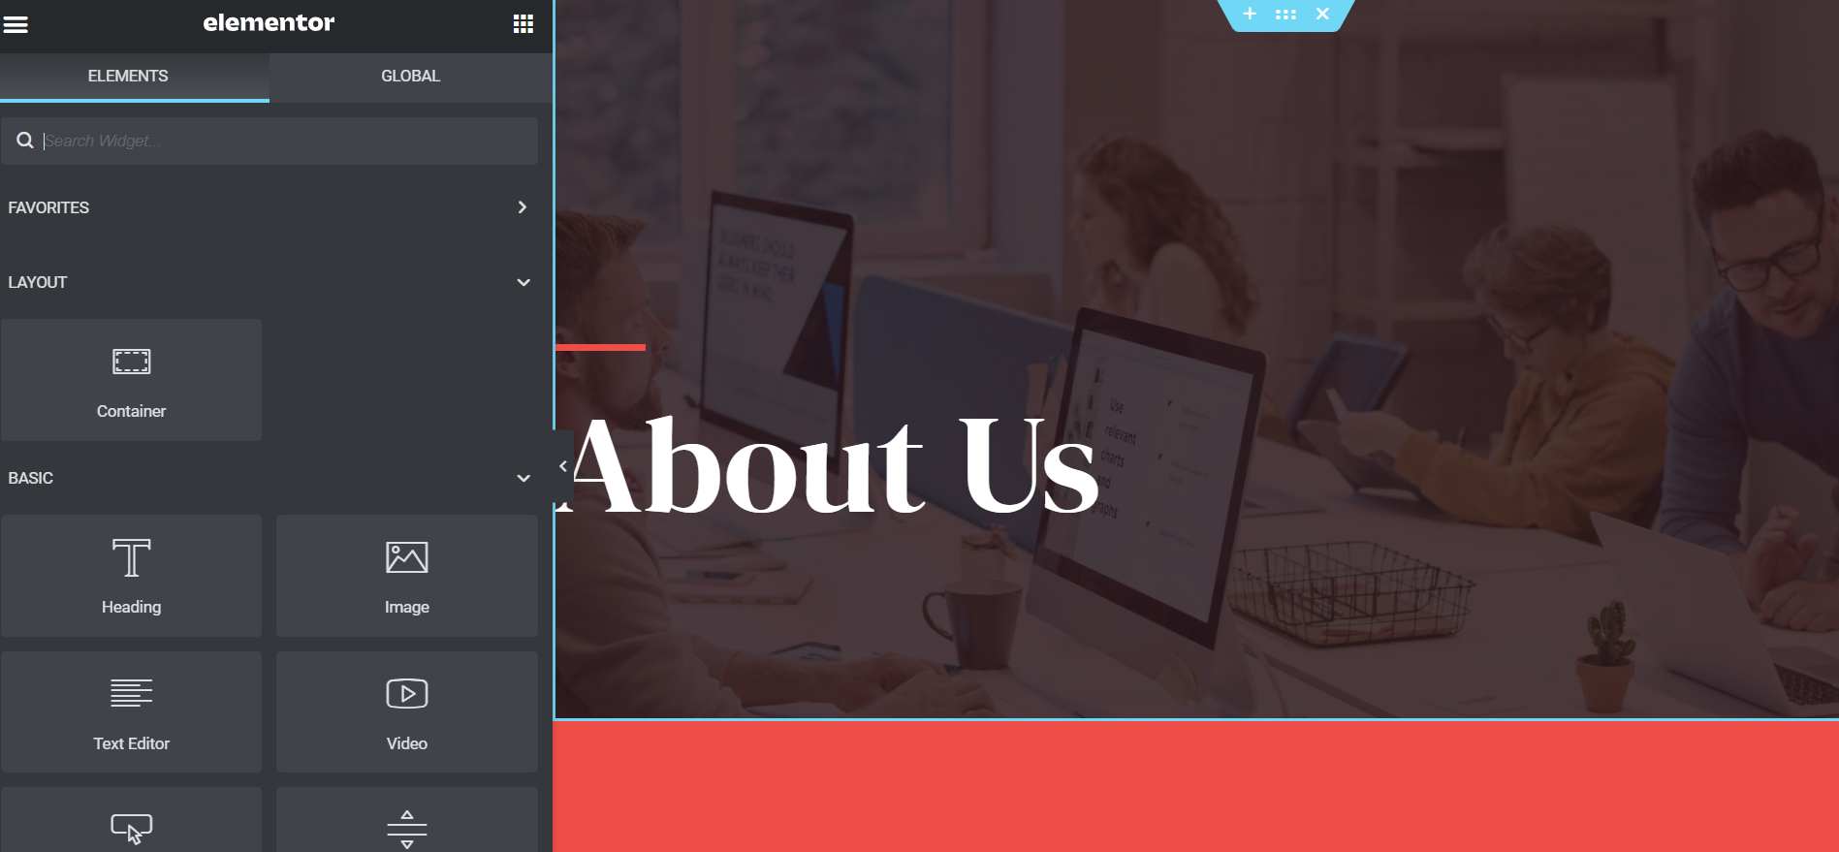
WORDPRESS WEBSITE DESIGNING

Slide 3
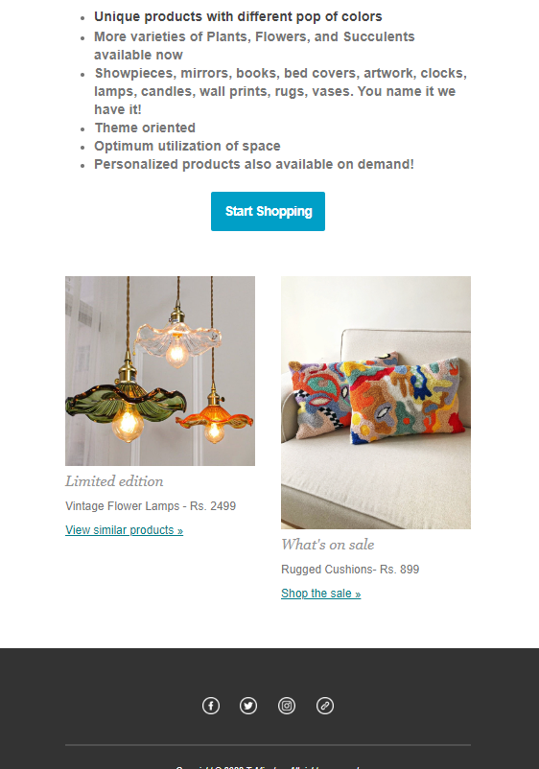

BULK EMAIL CAMPAIGN

Slide 4
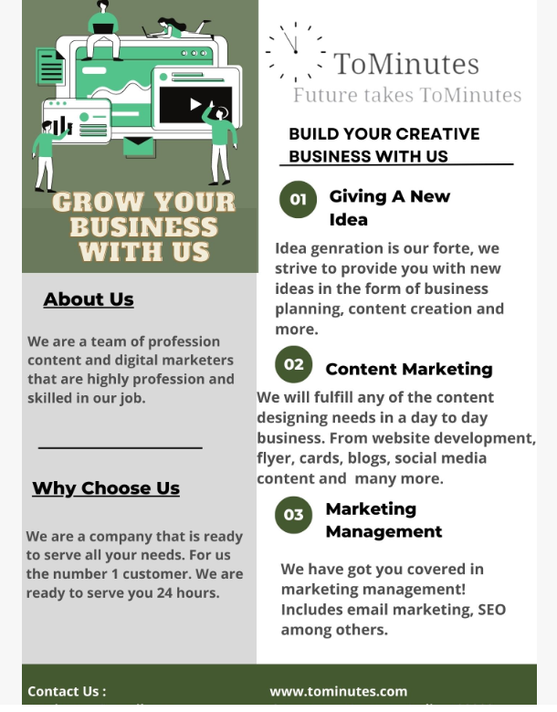
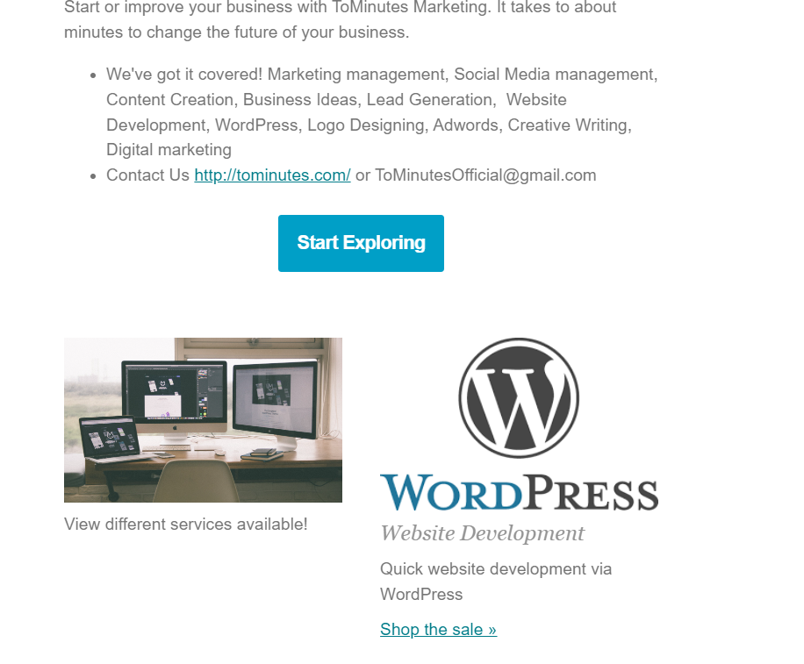
BULK EMAIL CAMPAIGN

Slide 5
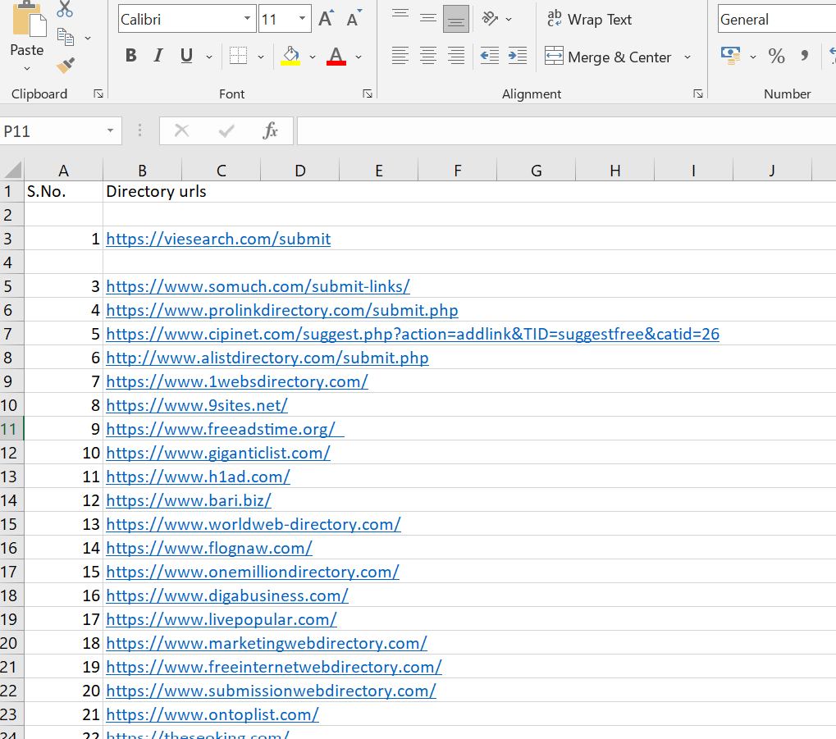
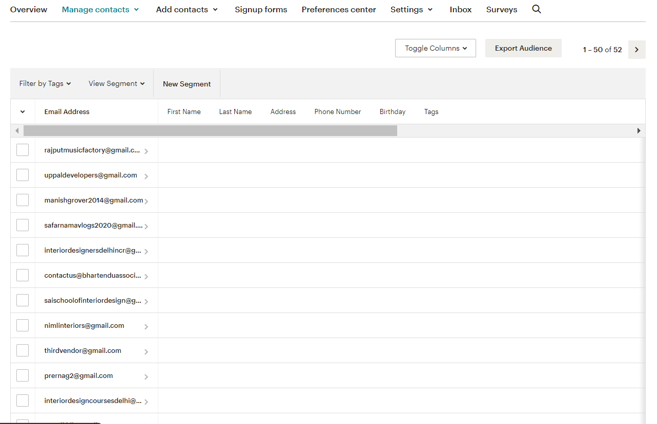
DIRECTORIES AND CONTACT EXTRACTION

Slide 6

IMAGE CONTENT- EMAIL POSTER

Slide 7


FLYER

Slide 8

BUSINESS CARD

Slide 9



LOGO DESIGN

Slide 10

FACEBOOK POST

